Slide 1
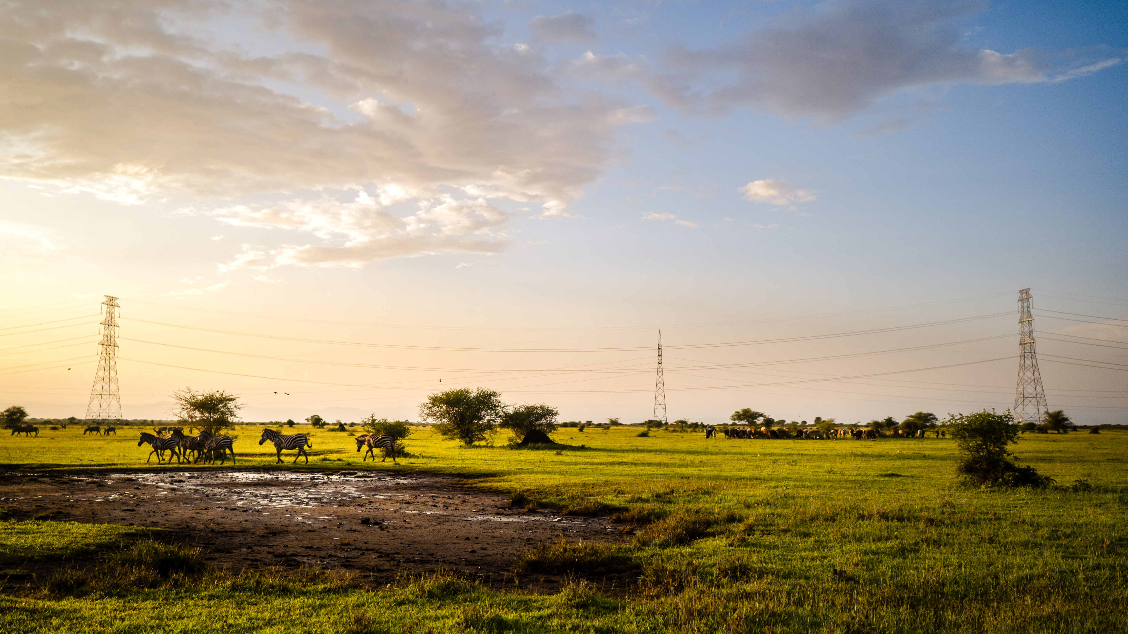
APAC
PROTECTED AREAS: DELIVERING BENEFITS FOR NATURE AND FOR PEOPLE.
The Africa Protected Area Congress (APAC) seeks to deliberately foster dialogues that build and empower the current and next generation of leaders to realize an African future where biodiversity is valued as an asset that contributes to development.
APAC
Kigali, Rwanda
18-23 July 2022
KIGALI, RWANDA
18-23 JULY 2022
HONEYGUIDE WILL BE THERE, LET’S MEET UP.

Slide 2
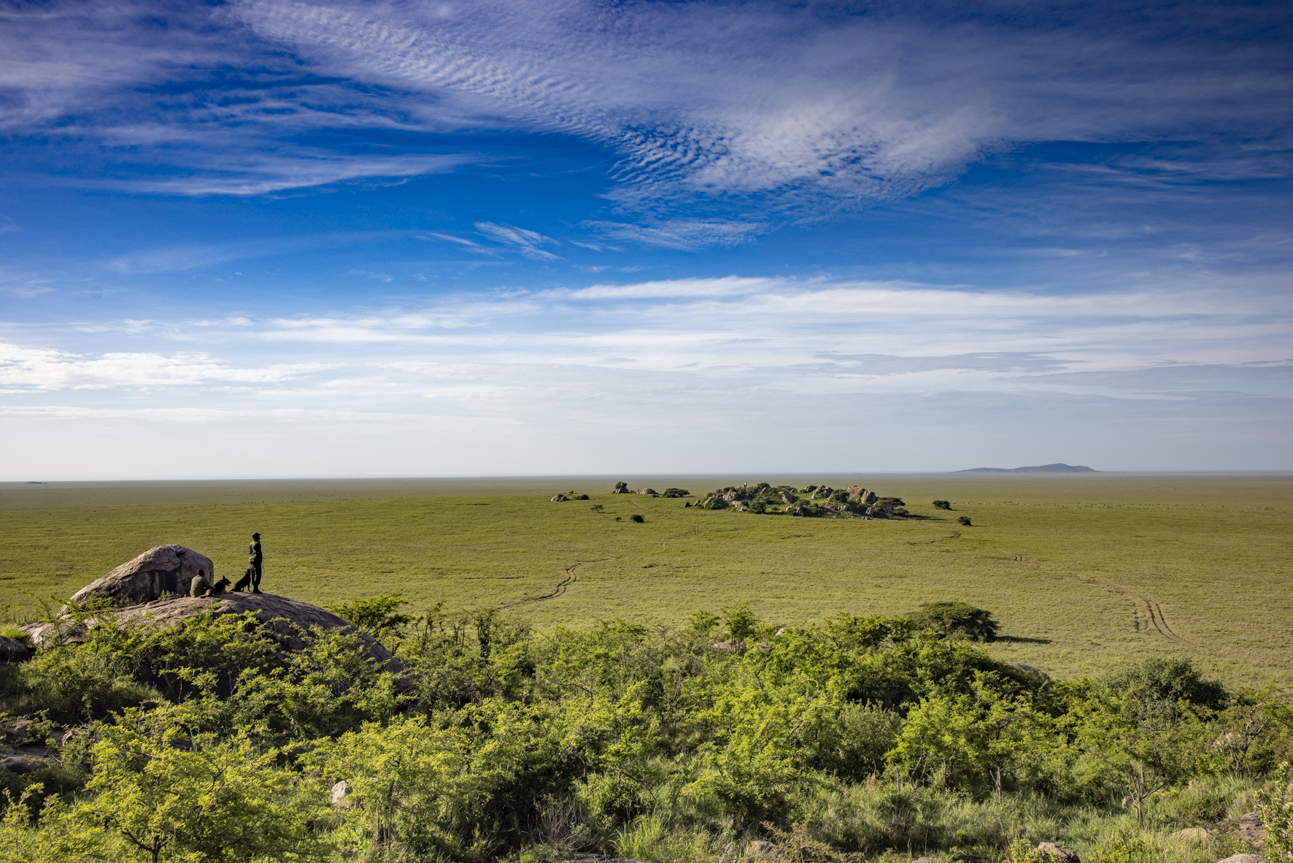
JOIN US AT ONE OF THESE EVENTS.
DATE AND TIME | DESCRIPTION OF SESSION | SESSION ID
Tuesday 19 July 16:00-17:30 | Workshop: Sam Shaba is presenting our Management Tools (MA&T) that strengthen management in conservancies, WMAs & partners. | 079-PCA-GOV
Wednesday 20 July 10:30-12:30 | Stream 2 Panel 2: Damian is joining a panel that will discuss Sustaining Community Conservation: The Need for New Funding Models and Practices. | ST-6
Wednesday 20 July 16:00-17:30 | Damian will join a panel discussion on the strategic planning process together with 4 other organizations who are all at different stages of the strategic planning process and will reflect on their experiences as they have navigated the process of strategic planning. | TNC
Thursday 21 July 14:15-15:00 | Damian, Sam and Meshurie will be presenting a TED styled talk on Balancing professionalization with traditional governance systems in community wildlife management areas. | SUSTAINABILITY AND RESILIENCE PAVILION
Thursday 21 July 16:00-17:30 | Damian will join the knowledge Café : Inclusive governance is critical in conservation & sustainable use. Peer-to-peer learning between practitioners is key to finding solutions & we will link practitioners & provide a platform for exchange & mutual learning on governance. | 079-PCA-PEO-GOV
Saturday 23 July 10:30-12:00 | We have jointly developed a panel discussion: Moderated by John Kamanga, a discussion exploring the experiences of 5 community conservation leaders from different community lead conservation initiatives who are successfully impacting both people and wildlife. | 015-PEO-GOV

Slide 3
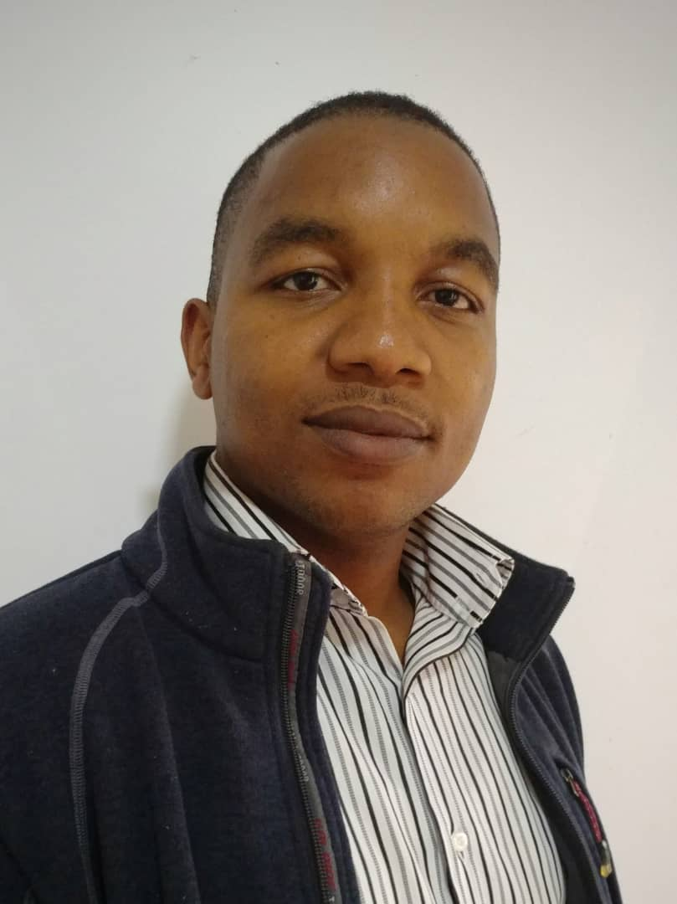
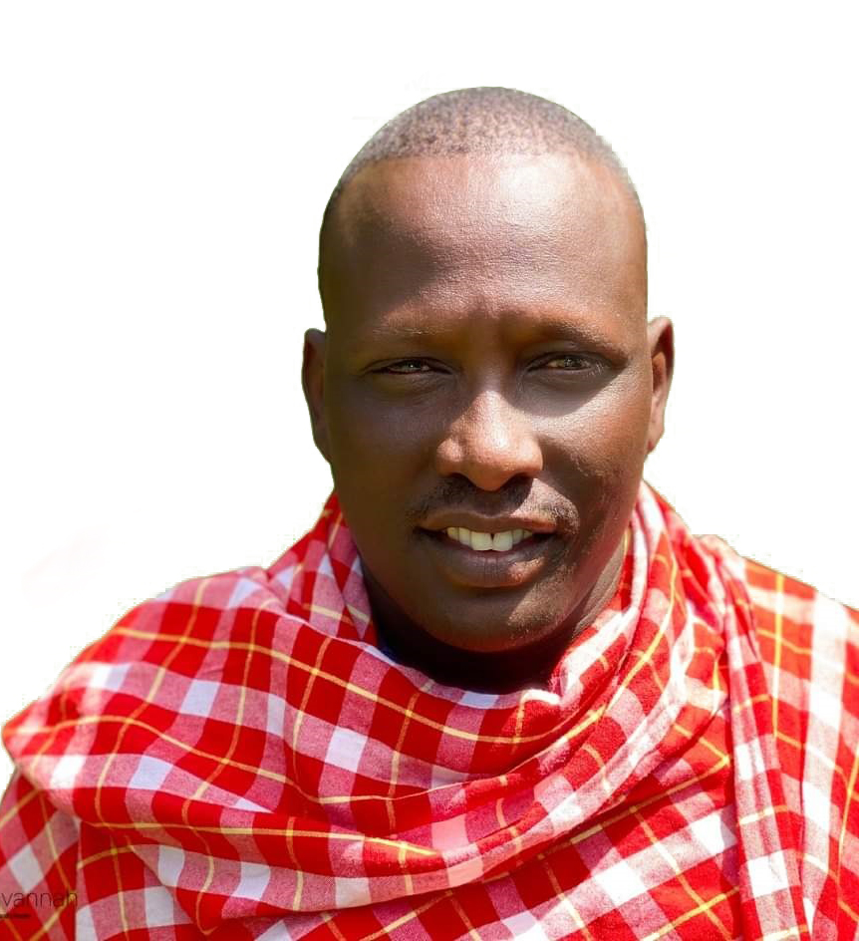
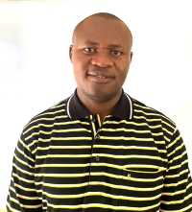
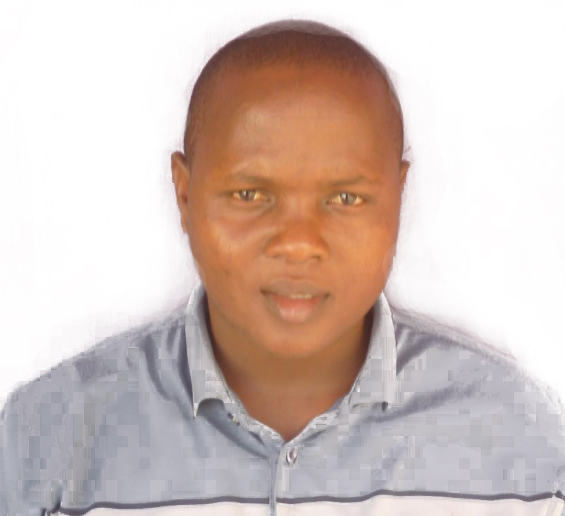
MEET THE TEAM
SUPUK OLEKAO
MANAGER
MAKAME WMA.
SUPUK OLEKAO
MANAGER
MAKAME WMA.
SUPUK OLEKAO
MANAGER
MAKAME WMA.
SUPUK OLEKAO
MANAGER
MAKAME WMA.

Slide 4
THANKS TO OUR SUPPORTERS
“There needs to be a shift away from economic models that value growth for growth’s sake towards a circular economy. We must engage with local communities, drawing on traditional knowledge, and promote the inclusion of women and indigenous populations in bioprospecting and other sectors.”
H.E. President Cyril Ramaphosa- President of South Africa

Slide 5
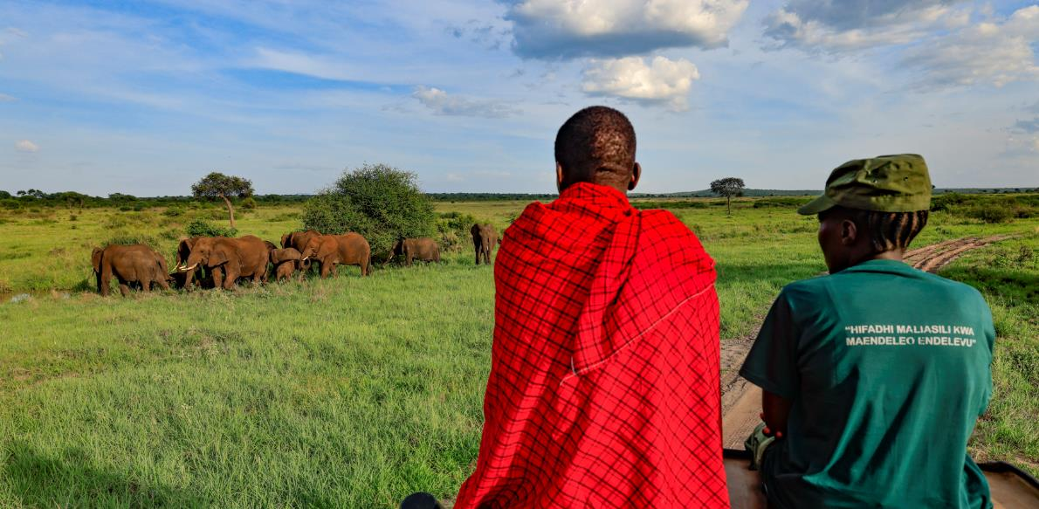
MAKING PEOPLE AND WILDLIFE INTERDEPENDENT

Slide 6
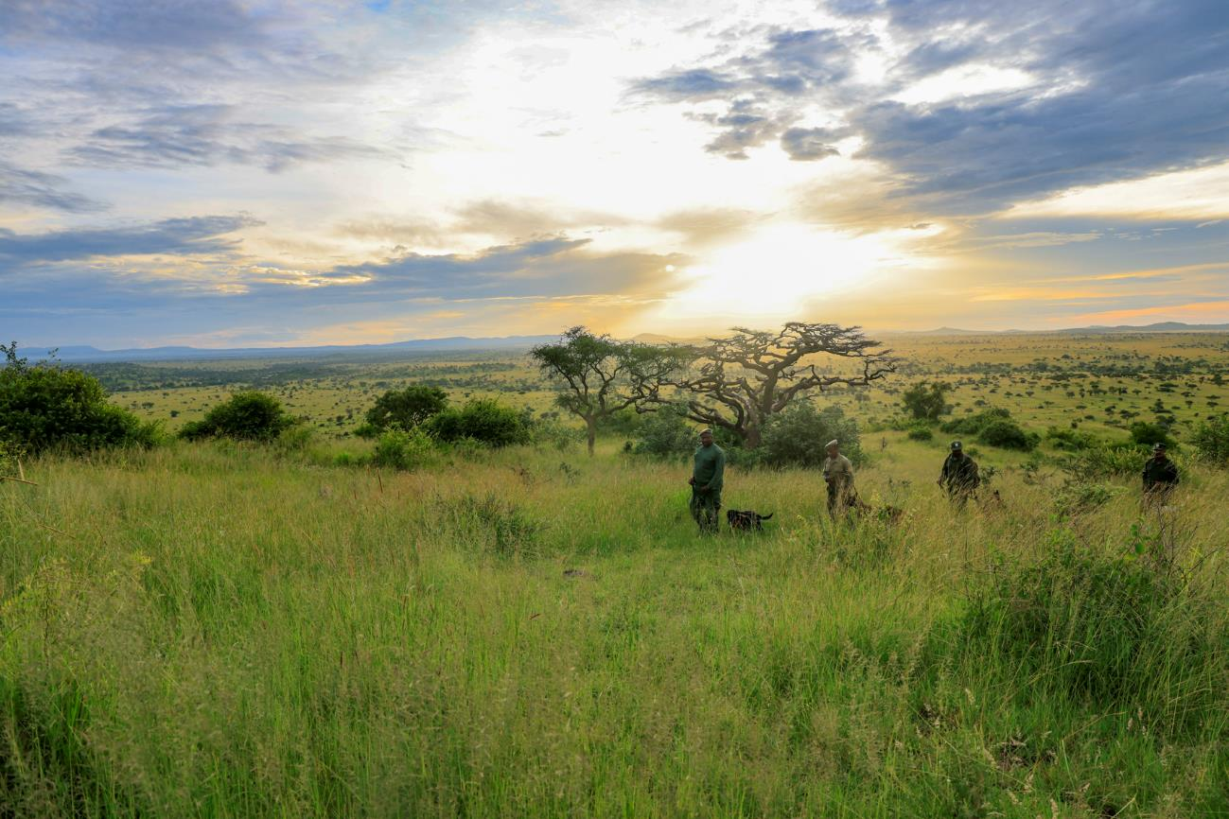
WWW.HONEYGUIDE.ORG INFO@HONEYGUIDE.ORG

